Slide 1
Rise of the Vegans
Team Pop loc. and drop(it)

Slide 2
Team Members
Corey Perkins
Yeni Perez
Dainty Cuevas
Krystal Dodd

Slide 3

Motivation
In our personal lives we like to make eco conscious choices, so we were curious about the accessibility of vegan options in the USA. We also had preconceived notions about this dietary popularity and wanted to test our biased opinion.
Notes:
Explain what preconceived ideas.

Slide 4
General Hypothesis
Alternative
Null
The number of vegan restaurants in urban(50,000+ people) areas will be greater than rural areas (less than 50,000 people)
If the city population is larger than 50,000 (urban area) then the percentage of vegan restaurants will NOT be higher than in cities with populations less than 50,000 (rural area).
If the city population is larger than 50,000 (urban area) then the percentage of vegan restaurants will be higher than in cities with populations less than 50,000 (rural area).

Slide 5
Tidying up
Data Cleanup:
Census Data Issues:
Excel file provided by the US Census data this file contained all cities and unincorporated towns for the entire USA and at some points summed geographical locations
We only incorporated locations with population over 1,000 (people)
Removed counties
Yelp Data Issues:
Data was provided as a dictionary of lists
Had to create a loop to parse out the data to be provided as columns
Category field resulted in a list
Created new dataframe to separate these values out into columns and then re- incorporated this back into dataframe
Only had 5,000 calls a day
Created a rate limit to prevent over calling
Search radius parameter
Used a 5 mile after testing smaller search areas we wanted to provide a large enough area for results and show similar outcomes to real life scenarios.
Notes:
Census data-used to get cities that we would pull restaurant data for.
Yelp Business Search API-used to retrieve the restaurant data.
*Delivery usually available within a 5 mile radius of a business*

Slide 6
Data Analysis

Slide 7
Methods
Data sources
Used API from Yelp business search: https://api.yelp.com/v3/businesses/search
https://www2.census.gov/programs-surveys/popest/datasets/2010-2019/cities/totals
Definitions:
Rural >1000 & < 50,000 population
Urban > 50,00 population
Used a 5 mile radius in our location search results
This is the typical delivery radius and would reflect real life scenarios
Process:
Used a randomized sample of 100 urban areas and 100 rural areas from census using population estimate for 2019
From this randomized sample an API call was created to yelp that merged the city and state to pull location, business name, and categories.

Slide 8
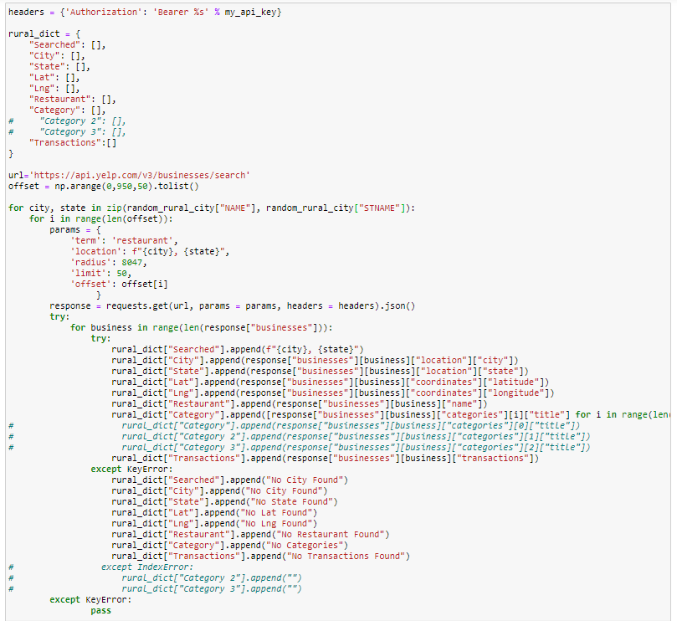
Methods
Created a for loop to parse out API response .
Received key errors in order to circumvent the error an except and try were added .
Once the response data was collected we merged this with the population data from the census.
This was our final dataframe used to create the graphs and values.
Received duplicative results when merging data frames these values were dropped.
Notes:
COREY START HERE

Slide 9
Dora the Explorer
Data Exploration
Examined for null values
Investigate the validity of the data and relevance to reporting
Used the .describe () for central tendency
Used min/max to understand outliers
Insights from logic
That not all of the locations pulled from yelp had Latitude/Longitude values
Notice outliers and realizing the census used summed data for large geographical areas.
This resulted in further data cleaning

Slide 10
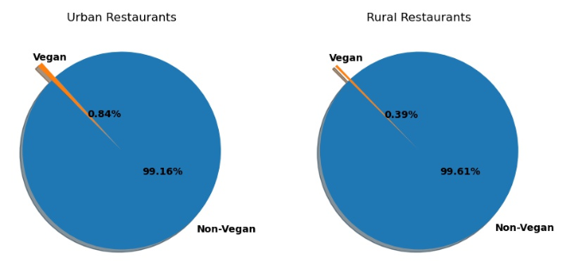
π Charts
Question: What percentage of businesses were categorized as vegan restaurants relative the to total pulled?
Notes:
115 percent difference Urban and Rural vegan restaurant totals

Slide 11
Urban
Rural
Notes:
Urban on average has more restaurants and more vegan restaurants less per capita
Rural has less restaurants but per higher per capita

Slide 12
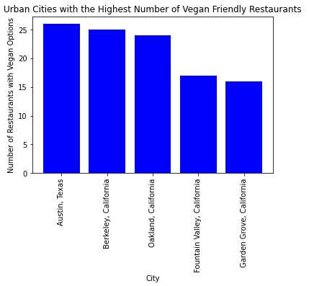
Bar Graphs
Question: What are the Top 5 Urban cities with highest number of vegan restaurants from the randomized sample?
Austin, Texas
Berkeley, California
Oakland, California
Fountain Valley, California
Garden Grove California

Slide 13
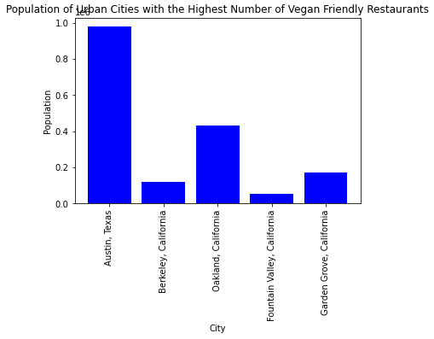
Bar Graphs
Question: What is the population of these cities with the highest number of vegan restaurants from the randomized sample?
Austin, Texas
Oakland, California
Garden Grove, California
Berkeley, California
Fountain Valley, California
*Population scaled to 1 Million
Notes:
1.0 = 1 Million
Scaled to 1

Slide 14
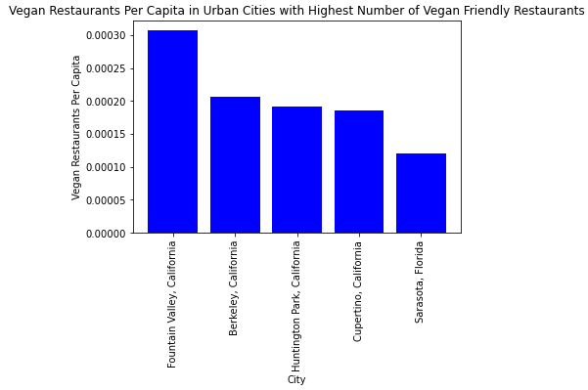
Bar Graphs
Question: Which cities have the highest vegan per capita in these cities from the randomized sample?
Fountain Valley, California
Berkeley, California
Huntington Park, California
Cupertino, California
Sarasota, Florida
Notes:
Per capita = the # vegan restaurants/population
While Fountain valley did not have the highest number of restaurants it does have the highest per capita, this is a significant metric to determine accessibilty for the population of people who live there.

Slide 15
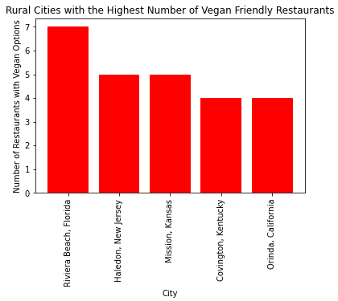
Bar Graphs
Question: What are the Top 5 Rural cities with highest number of vegan restaurants from the randomized sample?
Riviera Beach, Florida
Haledon, New Jersey
Mission, Kansas
Covington, Kentucky
Orinda, California

Slide 16
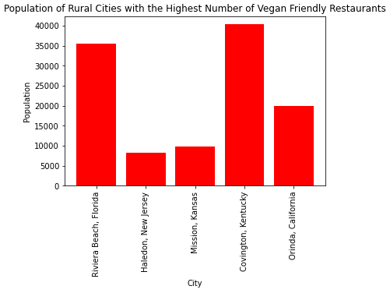
Bar Graphs
Question: What is the population of these cities with the highest number of vegan restaurants from the randomized sample?
Covington, Kentucky
Riviera Beach, Florida
Orinda, California
Mission Kansas
Haledon, New Jersey
Notes:
Fix slide

Slide 17
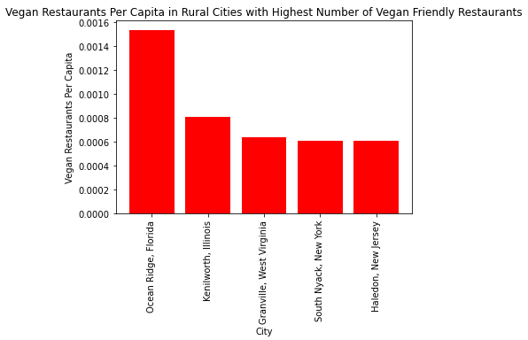
Bar Graphs
Question: Which cities have the highest vegan restaurants per capita in from the randomized sample?
Ocean Ridge, Florida
Kenilworth, Illinois
Granville, West Virginia
South Nyack, New York
Haledon, New Jersey
Notes:
Per capita = the # vegan restaurants/population
The highest per capita rural is much higher than urban per capita

Slide 18
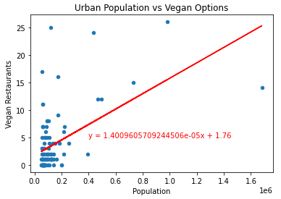
Scatterplots
Question: What is the relationship between population total of each random city and number of vegan restaurants? *Population scaled to 1 million
The r-value is: 0.5311535229130344 & the correlation coefficient is 0.53
Notes:
Moderate positive correlation with population in reference to vegan restaurants

Slide 19
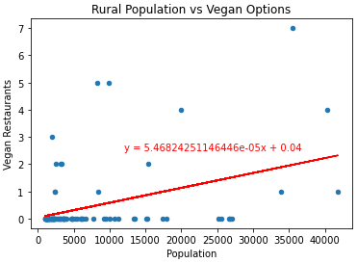
Scatterplots
Question: What is the relationship between population total of each random city and number of vegan restaurants?
The r-value is: 0.4079222987270247 & the correlation coefficient is 0.41
Notes:
Weak Positive correlation with population in reference to vegan restaurants

Slide 20
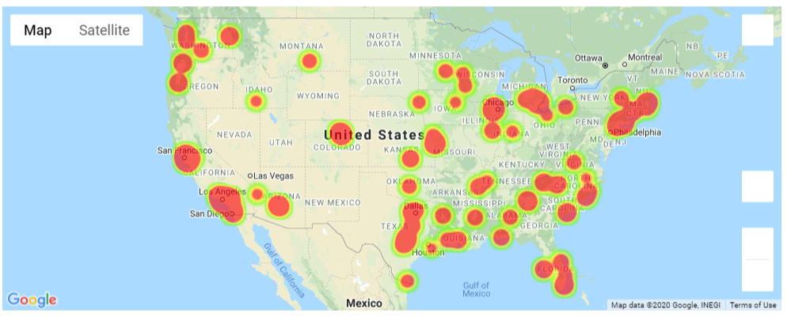
It’s Getting Hot in Here (Urban)

Slide 21
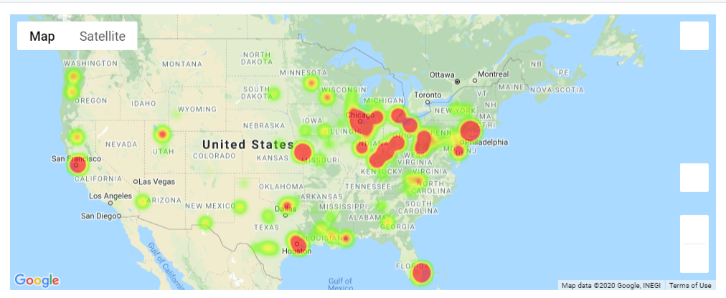
It’s Getting Hot in Here (Rural)
Where in the US is the concentration of vegan restaurants?

Slide 22
What Did We Find
Surprised by the results when examining per capita with rural data.
While the total number of restaurants was lower in rural the per capita was higher than urban.
While the per capita for the top 5 is higher based on T score these are skewed to outliers.
With our Rural heat maps the population of this specific area is smaller than urban the number of vegan restaurants shows to be more concentrated around major cities.
Also with the rural areas the number of vegan restaurants reflects a high level of bicoastility, where as with the urban there is a presence of these establishments in central US.
Our scatter plots also show a much stronger positive correlation with Urban population and number of restaurants in comparison to the rural graph
T - Test
Independent T- Test was performed to examine the Urban vs. Rural Vegan Restaurants per Capita
The p-value is: 6.473808292231837e-06
This value suggests we can reject the null hypothesis and conclude the number of vegan restaurants in an area is correlated with an increase in population

Slide 23
Post Mortem

Slide 24
Limitations and Issues
The generalized definition of rural vs. urban
We were aware that there was a likelihood that the generalized rural and urban definitions from the census would pose issues as well as the happenstance of these rural areas being located on the outskirts of urban.
With yelp we can only return 1,000 restaurants per city
This may have skewed our data so we are not reporting as many vegan restaurants that are present in an urban city
For example NY has 36,0000 results
Yelp only allows 3 category selections for restaurants
For instance a restaurant could have vegan options but not have selected the category as an identifier
The maintenance of the pages is left to the restaurants
Restaurants have to self identify their category selections

Slide 25
If We Had More Thyme
We would want to examine the number of vegan restaurants that have opened over time for these areas.
Yelp reviews:
How many star ratings and comments have these restaurants received compared to other restaurants?
Perform this study on a larger sample size
View the density based on “College Towns”
Narrow the results down to local options
How the pandemic affected the transactions of these restaurants?

Slide 26
Thank you! Any Questions?

